Slide 1
NSTX-U High-k Scattering receiver optical calculation and calibration
Xinhang Xu
7/25/2024

Slide 2
introduction
3D structure of Receive Optical
Sketch of the NSTX-U High-k Scattering Receiver Geometry
Receiver optical calibration
Error analysis
Software development
Summary

Slide 3
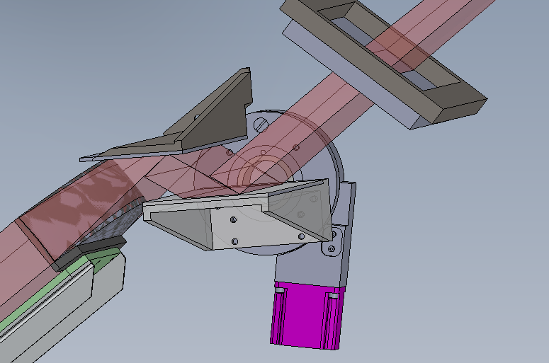
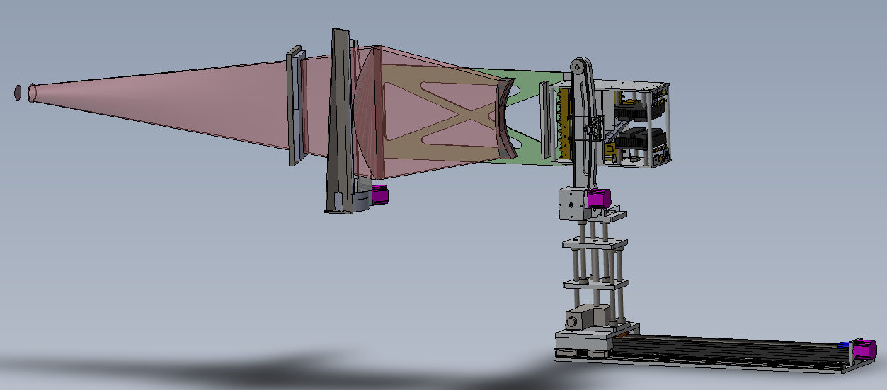
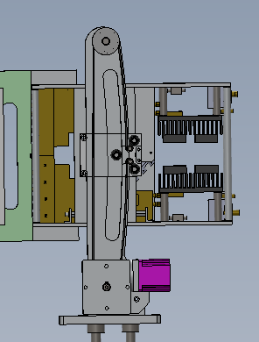
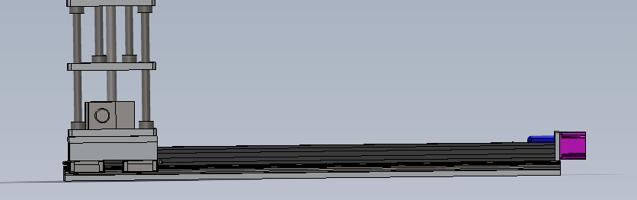
3D structure of Receive Optical
Toroidal antenna Motor
Window
Focus point
R antenna Motor
Z antenna Motor
Tilt antenna Motor

Slide 4
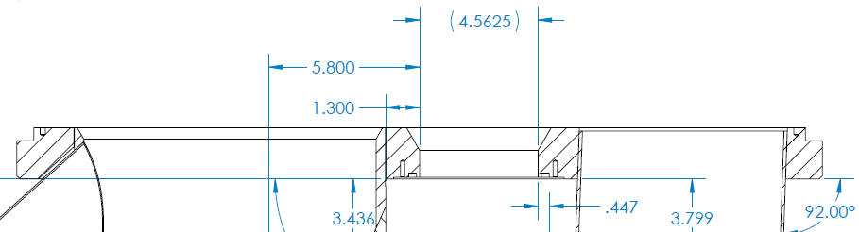
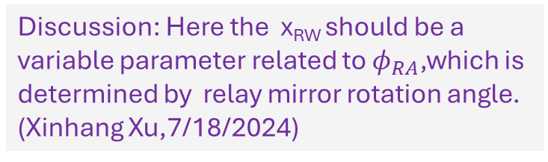
NSTX-U High-k Scattering Receiver Geometry(By Calvin and Xianzi)
Torus Center
ψ_{RA}
x_{RW} = x-axis offset of receiver beam on window (nominally half of window width or 58 mm)
φ_{RA} = horizontal tilt of receiver array and optics (between 11.39 and 15.39°)
z_{IR} = distance from window to interaction region (between 200 and 850 mm)
z_{IR} = distance from window to interaction region (measured along plasma midplane)
R_{RW} = major radius of vacuum window (fixed)
R_{IR} = major radius of interaction region
ψ_{RA} = toroidal tilt angle of interaction region (w.r.t. plane of vacuum window)
ψ_{R} = toroidal tilt angle between receiver beam and Radius vector (from torus center)
R_{IR}
Toroidal tilt angle due to x-axis offset: ψ_{X} = tan^{‒1}(x_{RW}/R_{RW})
φ_{RA} = φ_{RA} + ψ_{X}
R_{RW}² = R_{RW}² + x_{RW}²
R_{IR}² = R_{RW}² + z_{IR}² – 2R_{RW}·z_{IR}·cos(φ_{RA})
ψ_{RA} = ψ_{X} + sin^{‒1}((z_{IR}/R_{IR})·sin(φ_{RA}))
ψ_{R} = ψ_{RA} + φ_{RA}
ψ_{X}
ψ_{R}
Interaction Region (IR)
R_{RW}
R_{RW}
z_{IR}
Discussion: Here the x_{RW} should be a variable parameter related to $φ_{RA}$,which is determined by relay mirror rotation angle. (Xinhang Xu,7/18/2024)
φ_{RA}
φ_{RA}
Bay L Port Cover
x_{RW}
Window

Slide 5
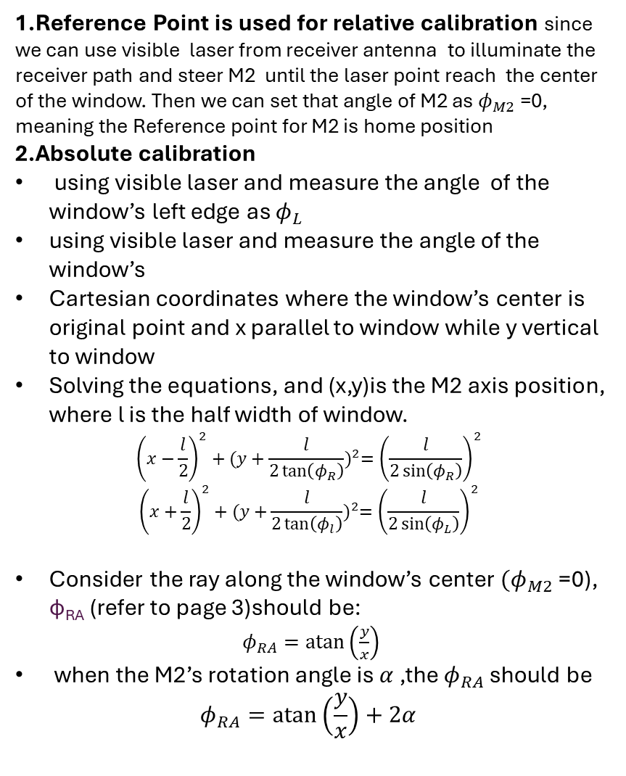


High-k Receiver optical Calibration: find the position of M2 axis which determine the angle of $φ_{RA}$
1.Reference Point is used for relative calibration since we can use visible laser from receiver antenna to illuminate the receiver path and steer M2 until the laser point reach the center of the window. Then we can set that angle of M2 as $φ_{M2}$ =0, meaning the Reference point for M2 is home position
2.Absolute calibration
using visible laser and measure the angle of the window’s left edge as $φ_{L}$
using visible laser and measure the angle of the window’s
Cartesian coordinates where the window’s center is original point and x parallel to window while y vertical to window
Solving the equations, and (x,y)is the M2 axis position, where l is the half width of window.
$${\left(x−\frac{l}{2}\right)}^{2}+{(y+\frac{l}{2\tan\left(φ_{R}\right)})}^{2}={\left(\frac{l}{2\sin\left(φ_{R}\right)}\right)}^{2}$$
$${\left(x+\frac{l}{2}\right)}^{2}+{(y+\frac{l}{2\tan\left(φ_{l}\right)})}^{2}={\left(\frac{l}{2\sin\left(φ_{L}\right)}\right)}^{2}$$
Consider the ray along the window’s center $(φ_{M2}$ =0), φ_{RA} (refer to page 3)should be:
$φ_{RA}=\operatorname{atan}\left(\frac{y}{x}\right)$
when the M2’s rotation angle is $α$ ,the $φ_{RA}$ should be
$$φ_{RA}=\operatorname{atan}\left(\frac{y}{x}\right)+2α$$
Torus Center
Reference Point
Bay L Port Cover
φ_{RA}
$$φ_{R}$$
$$φ_{L}$$
M1
M2
Distance from M2 axis to center of window :153.9mm
Right max angle of the edge:12.739degree
Left max angle of the edge:19.764degree
L_{OFF-AXIS}=131.3mm

Slide 6
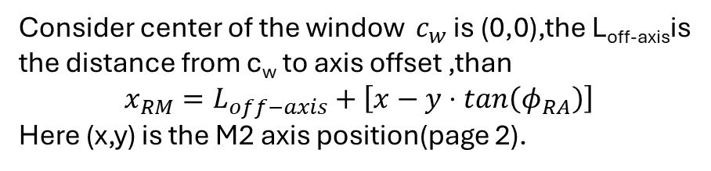

High-k Receiver optical Calibration: Calculate X_{RA}
φ_{RA}
Consider center of the window $c_{w}$ is (0,0),the L_{off-axis}is the distance from c_{w} to axis offset ,than
$$x_{RM}=L_{off−axis}+\left[x−y⋅tan\left(φ_{RA}\right)\right]$$
Here (x,y) is the M2 axis position(page 2).
x_{RW}
c_{w}(0,0)
$$L_{off−axis}$$
Window
(x,y)
M2

Slide 7



Error analysis
Given $φ_{L}={25}^{o},φ_{R}={19}^{o}$,L=70mm
x₀=-58.65mm, y₀=-154.42mm,$φ_{RA0}={20.8}^{o}$
$$abs(φ_{RA}−φ_{RA0})(deg)$$
1.1º error shift correspond to 4mm distance shift on the window, given the laser beam size is about 4mm, the error range could be ideally contained in 1º
2.This method only can make sure the incident angle error in 6º

Slide 8
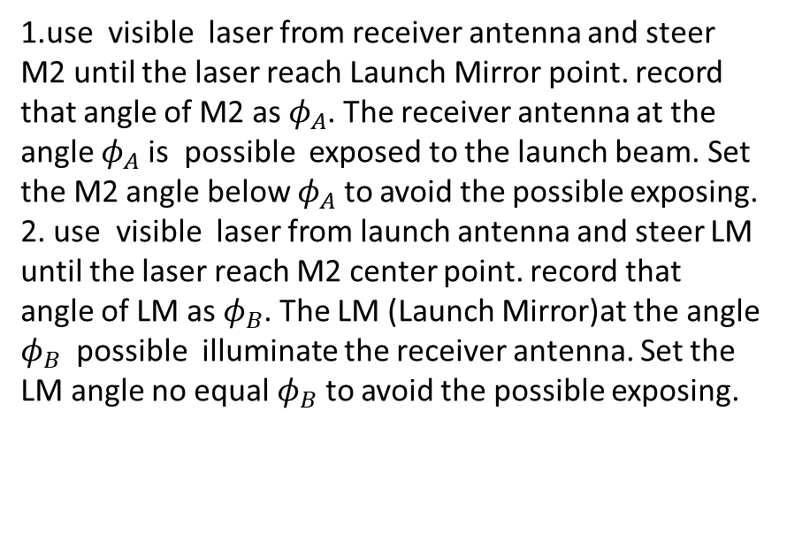
Way to Avoid exposing any of the receiver channels to the direct launch beam
Bay G Launch Mirror
(LM)
1.use visible laser from receiver antenna and steer M2 until the laser reach Launch Mirror point. record that angle of M2 as $φ_{A}$. The receiver antenna at the angle $φ_{A}$ is possible exposed to the launch beam. Set the M2 angle below $φ_{A}$ to avoid the possible exposing.
2. use visible laser from launch antenna and steer LM until the laser reach M2 center point. record that angle of LM as $φ_{B}$. The LM (Launch Mirror)at the angle $φ_{B}$ possible illuminate the receiver antenna. Set the LM angle no equal $φ_{B}$ to avoid the possible exposing.
Reference Point
Interaction Region (IR)
Bay L Port Cover
M1
M2

Slide 9
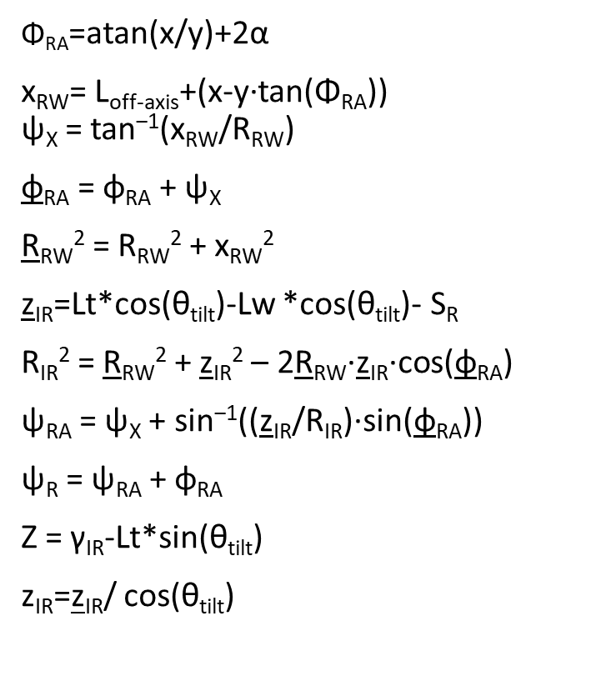
Input parameters:
S_{R} = receiver optical radical distance
θ_{tilt} = poloidal tilt angle of receiver optical
α = M2(mirror 2) rotation angle，α∈(-9º,6º)
γ_{IR} = IR height above midplane
Constant parameters :
L_{off-axis} = x-axis offset of receiver beam on window center (131.3mm).
R_{RW} = major radius of vacuum window (fixed)1873.5mm.
Lt = optical total length from receiver antenna axis to focus point(2088mm).
Lw =length from receiver antenna axis to window1 (1132mm) when SR=0.
x ,y = M2(mirror 2) position(M2 center to Window center :154mm,angle:13.76º)
Depend parameters:
R_{IR} = major radius of interaction region
ψ_{RA} = toroidal tilt angle of interaction region (w.r.t. plane of vacuum window)
ψ_{R} = toroidal tilt angle between receiver beam and Radius vector (from torus center)
φ_{RA} = horizontal tilt of receiver array and optics (between 11.39 and 15.39°)
z_{IR} = distance from window to interaction region (between 200 and 850 mm)
z_{IR} = distance from window to interaction region (measured along plasma midplane)
Z = antenna height above midplane
Torus Center
$\text{Φ}\text{RA}$=atan(x/y)+2α
x_{RW}= L_{off-axis}+(x-y·tan(Φ_{RA})) ψ_{X} = tan^{‒1}(x_{RW}/R_{RW})
φ_{RA} = φ_{RA} + ψ_{X}
R_{RW}² = R_{RW}² + x_{RW}²
z_{IR}=Lt*cos(θ_{tilt})-Lw *cos(θ_{tilt})- S_{R}
R_{IR}² = R_{RW}² + z_{IR}² – 2R_{RW}·z_{IR}·cos(φ_{RA})
ψ_{RA} = ψ_{X} + sin^{‒1}((z_{IR}/R_{IR})·sin(φ_{RA}))
ψ_{R} = ψ_{RA} + φ_{RA}
Z = γ_{IR}-Lt*sin(θ_{tilt})
z_{IR}=z_{IR}/ cos(θ_{tilt})
ψ_{RA}
R_{IR}
ψ_{X}
ψ_{R}
R_{RW}
Interaction Region (IR)
R_{RW}
z_{IR}
φ_{RA}
φ_{RA}
x_{RW}
Window

Slide 10
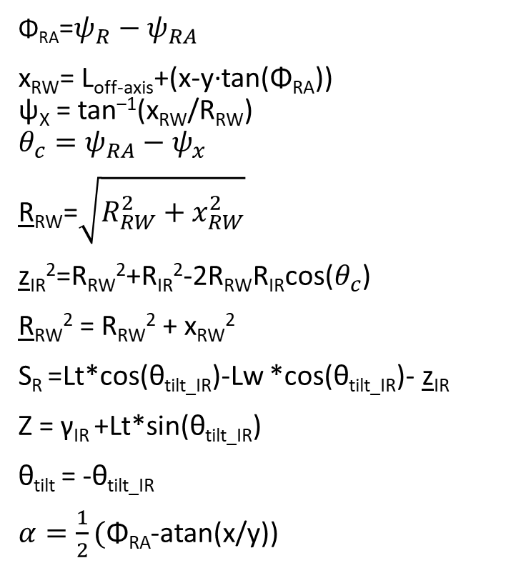
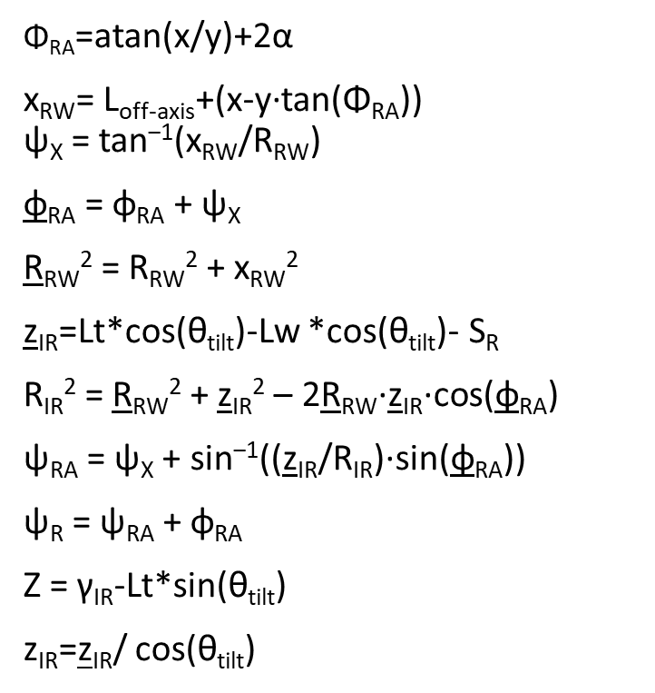
From Interaction region to antenna setup
Torus Center
ψ_{RA}
$\text{Φ}\text{RA}$=atan(x/y)+2α
x_{RW}= L_{off-axis}+(x-y·tan(Φ_{RA})) ψ_{X} = tan^{‒1}(x_{RW}/R_{RW})
φ_{RA} = φ_{RA} + ψ_{X}
R_{RW}² = R_{RW}² + x_{RW}²
z_{IR}=Lt*cos(θ_{tilt})-Lw *cos(θ_{tilt})- S_{R}
R_{IR}² = R_{RW}² + z_{IR}² – 2R_{RW}·z_{IR}·cos(φ_{RA})
ψ_{RA} = ψ_{X} + sin^{‒1}((z_{IR}/R_{IR})·sin(φ_{RA}))
ψ_{R} = ψ_{RA} + φ_{RA}
Z = γ_{IR}-Lt*sin(θ_{tilt})
z_{IR}=z_{IR}/ cos(θ_{tilt})
$\text{Φ}\text{RA}$=${ψ_{R}−ψ}_{RA}$
x_{RW}= L_{off-axis}+(x-y·tan(Φ_{RA})) ψ_{X} = tan^{‒1}(x_{RW}/R_{RW})
$$θ_{c}=ψ_{RA}−ψ_{x}$$
R_{RW}=$\sqrt{R_{RW}^{2}+x_{RW}^{2}}$
z_{IR}²=R_{RW}²+R_{IR}²-2R_{RW}R_{IR}cos($θ_{c}$)
R_{RW}² = R_{RW}² + x_{RW}²
S_{R} =Lt*cos(θ_{tilt_IR})-Lw *cos(θ_{tilt_IR})- z_{IR}
Z = γ_{IR} +Lt*sin(θ_{tilt_IR})
θ_{tilt} = -θ_{tilt_IR}
$α=\frac{1}{2}(\text{Φ}\text{RA}$-atan(x/y))
R_{IR}
ψ_{X}
ψ_{R}
R_{RW}
Interaction Region (IR)
R_{RW}
z_{IR}
φ_{RA}
φ_{RA}
x_{RW}
Window

Slide 11
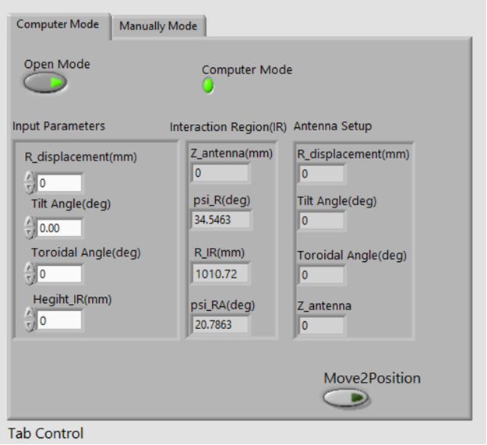
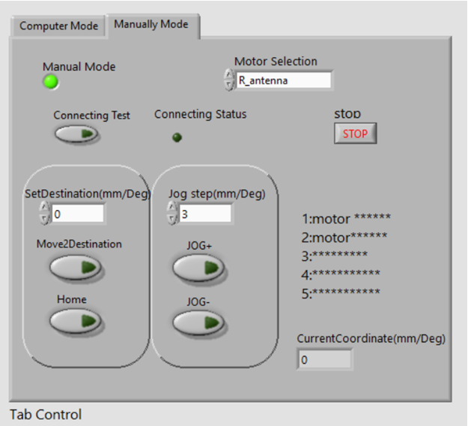
Control software

Slide 12
Summary :
1.Analysis the method for absolute calibration of receiver angle, which ensure the error range in 6⁰ .
2.Method to check the direct illumination angle between launch mirror and receiver mirror to avoid exposing
any of the receiver channels to the launch beam.
3. Develop software of receiver optical system for calculating the Interaction region and system position
control

Slide 13
appendix

Slide 14


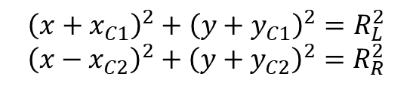
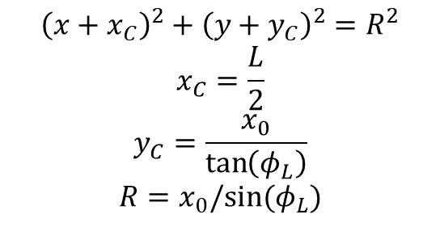

Geometrical relation between angle and mirror axis
Left edge(-L,0)
Window center(0,0)
Right edge(L,0)
$$φ_{L}$$
$${\left(x+x_{C1}\right)}^{2}+{\left(y+y_{C1}\right)}^{2}=R_{L}^{2}$$
$${\left(x−x_{C2}\right)}^{2}+{\left(y+y_{C2}\right)}^{2}=R_{R}^{2}$$
$$φ_{L}$$
$$φ_{R}$$
$${\left(x+x_{C}\right)}^{2}+{\left(y+y_{C}\right)}^{2}=R^{2}$$
$$x_{C}=\frac{L}{2}$$
$$y_{C}=\frac{x_{0}}{\tan\left(φ_{L}\right)}$$
$$R=x_{0}/sin⁡(φ_{L})$$
Mirror axis(x₀,y₀)

